Slide 1

Uzma Ali Apache Spark Made Easy!
MSc. Big Data – completion Apr 2017
BE – Computer Systems, PMP
Notes:
1 min

Slide 2
Agenda
About Today’s session
Advent of Big Data
What is Apache Spark?
Databricks Community Edition
Demo
Uzma Ali Apache Spark Made Easy!
Notes:
2 min

Slide 3
Today’s Session
Who is our audience today?
Introductory session to Apache Spark for Python Programmers
20 mins slides and 40 mins demo
We will use Databricks Community Edition for the demo
Uzma Ali Apache Spark Made Easy!
Notes:
5 min

Slide 4
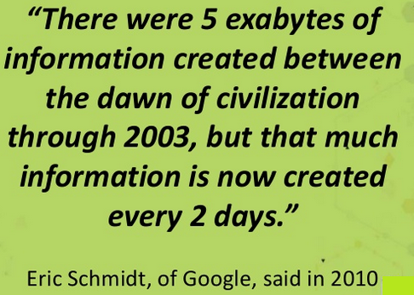
Advent of Big Data
1991
Terabytes
2017
Zettabytes
Uzma Ali Apache Spark Made Easy!
Notes:
6 min – 5 . Terabyte is 10 power 12. Zetta byte is 10 power 21. Exabyte is 10 power 18

Slide 5
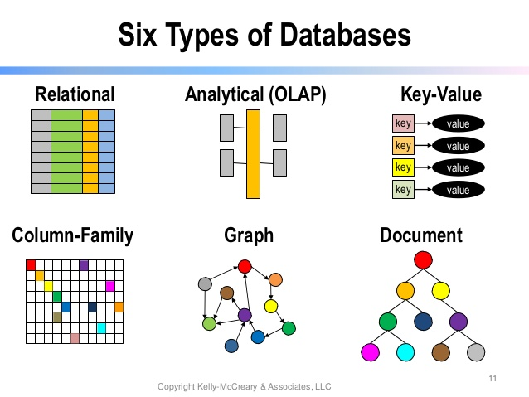
Is Database Technology keeping up with Big Data?
Uzma Ali Apache Spark Made Easy!
Notes:
8 min To handle the growing complex data, various types of databases have emerged. Relational database is the most popularly used and owns 90% of the database market.

Slide 6
What are Databases used for?
Transaction Processing
Banking
Book flights
Analytics / Business Intelligence
Global warming
Machine Learning / Predictive Analytics
Market basket analysis
Uzma Ali Apache Spark Made Easy!
Notes:
10 min - To handle the growing complex data, various types of databases have emerged. Relational database is the most popularly used and owns 90% of the database market.

Slide 7
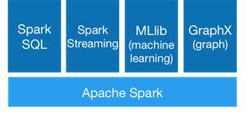
What is Apache Spark? How is it being used?
Apache Spark™ is a fast and general engine for large-scale data processing.
Used for analytics and predictive analytics
It can run on Hadoop, standalone, or in the cloud.
It can access diverse data sources including HDFS (Hadoop File System), Amazon S3 (cloud storage) and various noSQL Databases.
Spark Framework can be accessed in Scala, Python, Java and R
Uzma Ali Apache Spark Made Easy!
Notes:
13 min

Slide 8
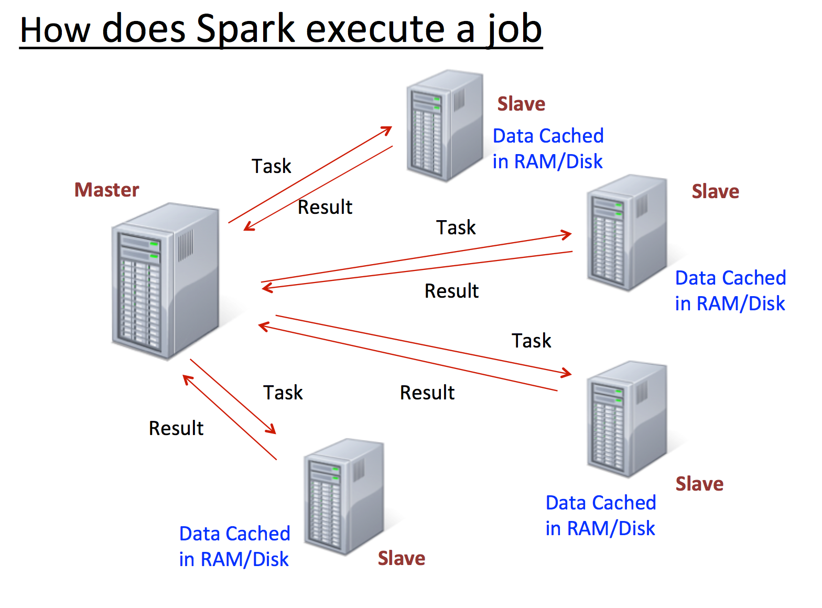
Apache Spark on a Hadoop Platform
Hadoop supports processing (MapReduce) and storage (HDFS) of large datasets over distruted computing environment
Spark is a cluster computing framework. It does not have a distributed filesystem, but can use HDFS.
Spark uses memory and disk for processing, whereas MapReduce strictly uses disk.
Uzma Ali Apache Spark Made Easy!
Notes:
16 mins

Slide 9
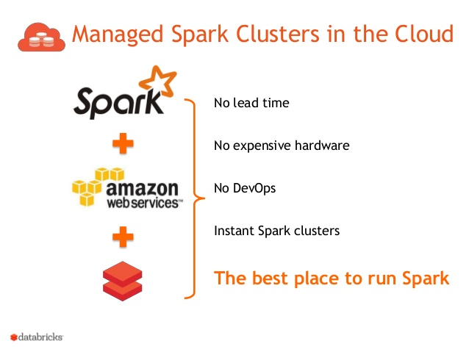
Databricks
Databricks offers fully managed Apache Spark cluster framework on the cloud.
The users can spend more time in doing interactive analytics rather than managing the infrastructure
Amazon web services is used as the underlying infrastructure.
Uzma Ali Apache Spark Made Easy!
Notes:
23 mins

Slide 10
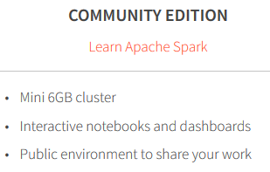
Today’s Demo on Databricks Community Edition
https://community.cloud.databricks.com
We will use Python as the language
We will work on world weather data from 1970-1971 and compare it to world weather data in 2015-2016
Dataset: ftp://ftp.ncdc.noaa.gov/pub/data/ghcn/daily/by_year
Uzma Ali Apache Spark Made Easy!
Notes:
24 mins

Slide 11

Demo Time!
Any Questions

